Slide 1
IST – 687 Introduction to Data Science Final Project Health Management Organization
12/08/2022

Slide 2


Project Overview
A dataset has been given with an overall goal to provide actionable insights based on the data and accurately predict which people will be expensive.
The data set has been provided by Health Management Organization.
Goal is to understand the key drivers of why some people are expensive and predict which people will be expensive in the future
On a more precise level, we have two major goals:
Predict people who will spend a lot of money on health care in the coming year
Provide actionable insights, in terms of how to lower the health care costs, by providing specific recommendations.

Slide 3
Assumptions
Through the process of the project, we have made a few assumptions, they are as follows:
The first assumption was determining the threshold above which the costs are considered expensive and what are inexpensive. For this, we first found that the median of the cost was $2,500 and then realized that more than 75% of the dataset was falling under the expensive category. Therefore, we considered a value between the 75th and 80th percentile, after a few calculations and combinations we went with the 78th percentile which is $5,353.00
The second assumption was that irrespective of the identical attributes, we considered each observation as a unique observation because the variables that we are dealing with in the dataset are general in nature.
The final assumption is to take age and gender into consideration. It is a known fact in data science that these variables could contribute to biases in the algorithms, but because we are dealing with a dataset that is related to the healthcare industry, gender and age play a pivotal role, hence it is important to take them into consideration.

Slide 4

Dataset and variables
After exploring the given data set, we have the following information:
Used the functions like str(), summary(), head() and tail() to understand the dataset better
The dataset consists of 7582 rows and 14 columns
Each row is a culmination of data from a separate individual
There are 14 variables that constitute information about age, BMI, no. of children, smoker, location, location type, education level, exercise, yearly physical, married, hypertension, gender, cost

Slide 5
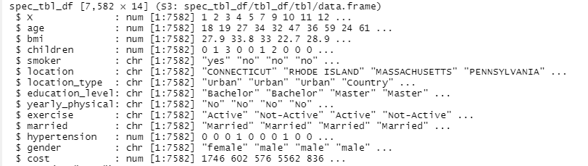
Data exploration

Slide 6
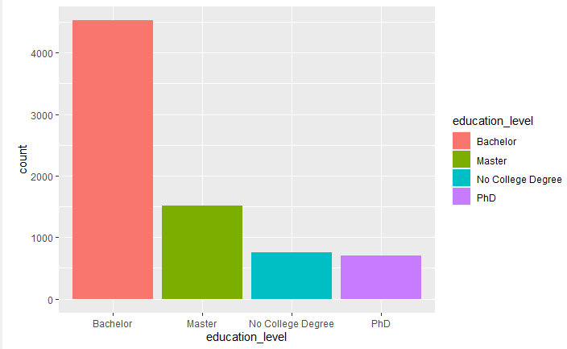
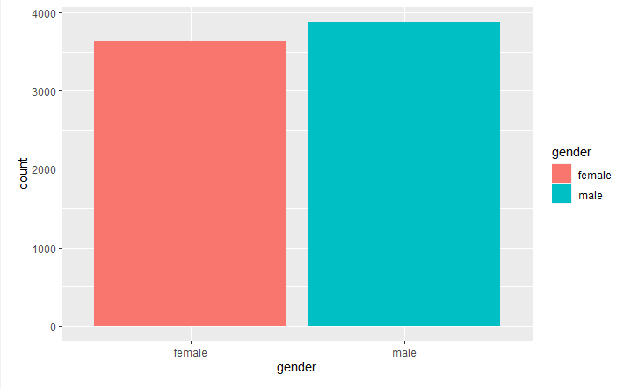
Data exploration
Based on the statistics that we gathered through the data exploration process; we have the following conclusions:
Nearly, 75% of the individuals contributing to the dataset are people that have been active members when it comes to exercising from the past year, whereas the remaining 25% are people who are not active.
Based on gender, both males and females contribute around equally to the dataset
Next, the number of people with a bachelor’s degree is of higher frequency contributing to nearly half of the dataset followed by people with a master’s degree
Next, we see around 66.7% are married whereas the remaining group of people is unmarried

Slide 7
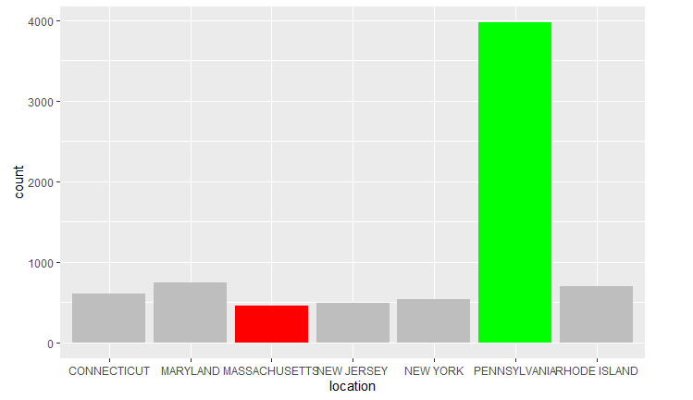
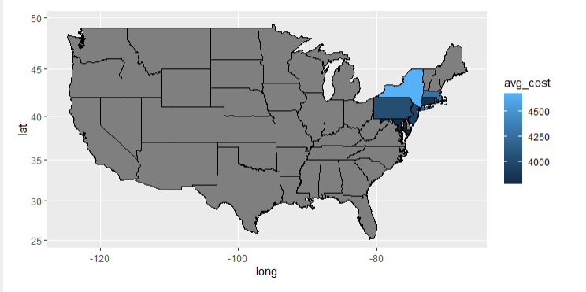
Data exploration in location

Slide 8

Data Cleaning
After exploring the given dataset, the next step was to clean the dataset and only keep the information that is required. To do so, the following two cleaning methods were performed:
We dealt with the null values using the na_interpolation from the imputeTS library for the BMI column
We cannot use mean or na_interpolation to fill in the missing values because the column for hypertension is of binary data type. Therefore, we will delete any rows when the hypertension property has missing values.
We factorized the columns using as.factor method to categorize them because it will be easy to analyze these later.

Slide 9

Business Questions
Which aspects of a person affect the healthcare costs the most?
Which aspects of a person moderately affect healthcare costs?
Which aspects of a person have the least effect on their healthcare costs?
Which age group spends the most on health care?

Slide 10
Which aspects of a person affect the healthcare the most?
We found that the factors that affect the healthcare cost most are:
1) Smoker
2) BMI
3) Exercise

Slide 11
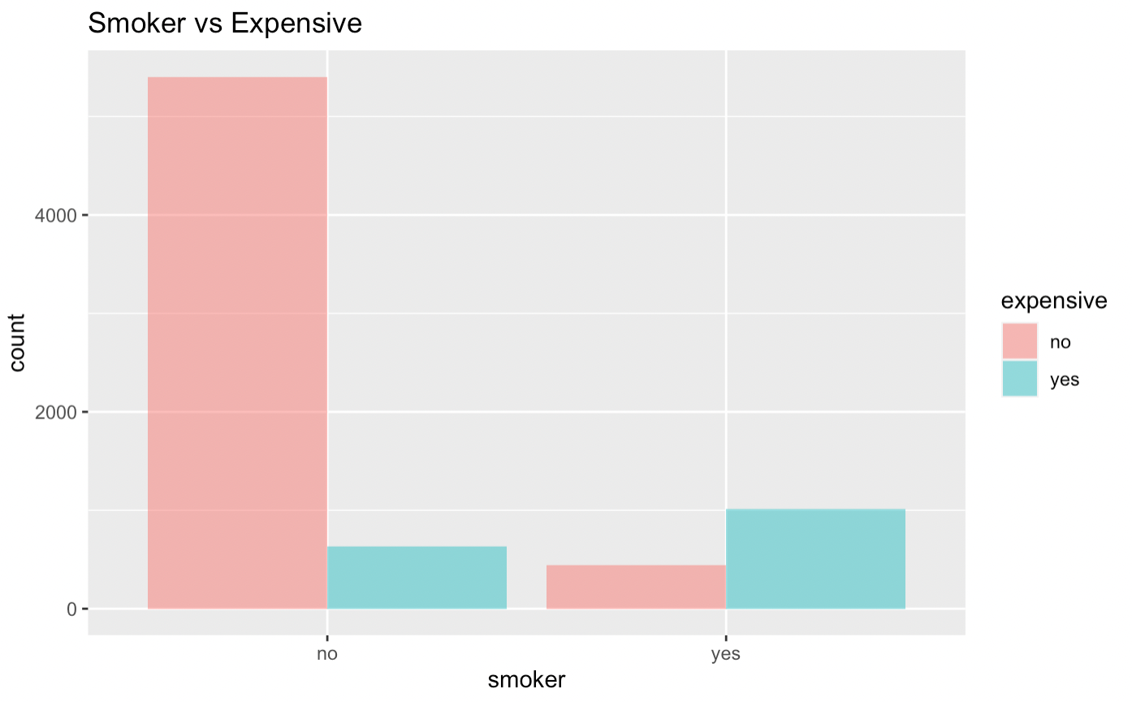
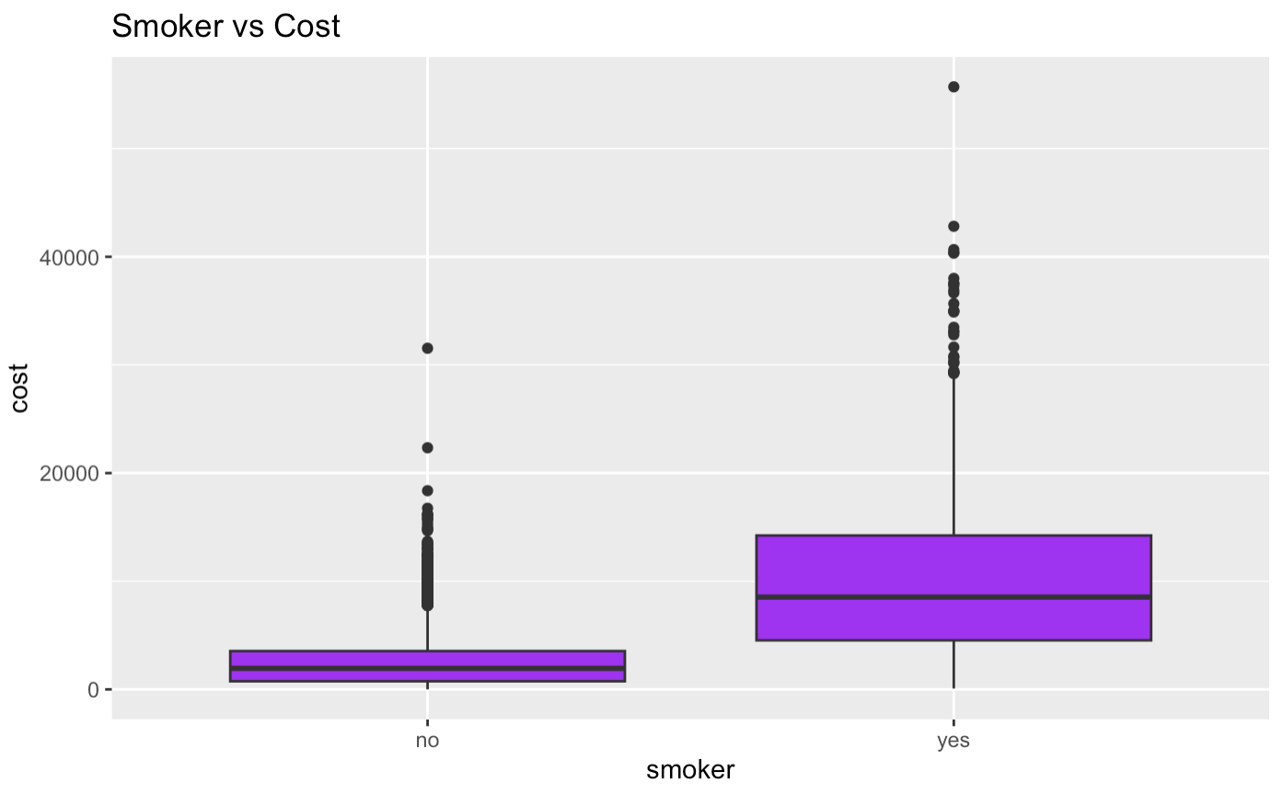
smoker

Slide 12
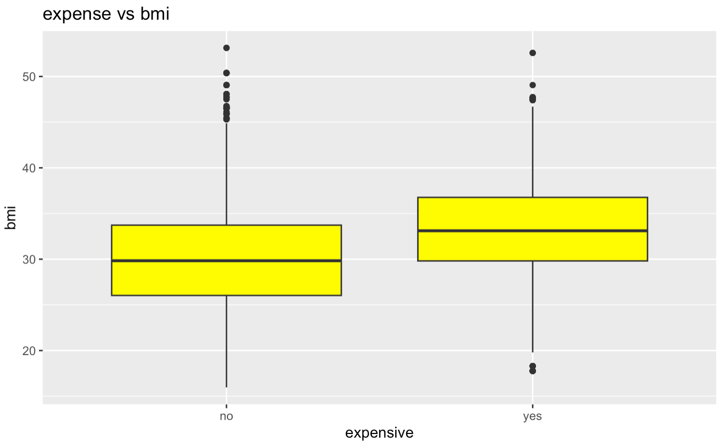
Body Mass index
We can refer to the below Boxplot of BMI for 2 categories: Expensive and not expensive.

Slide 13
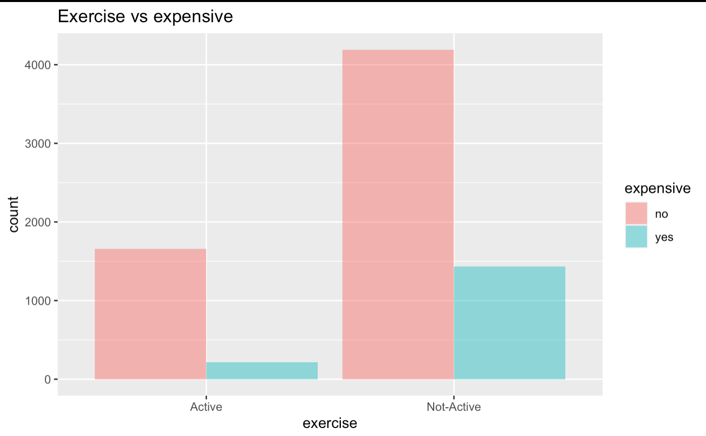
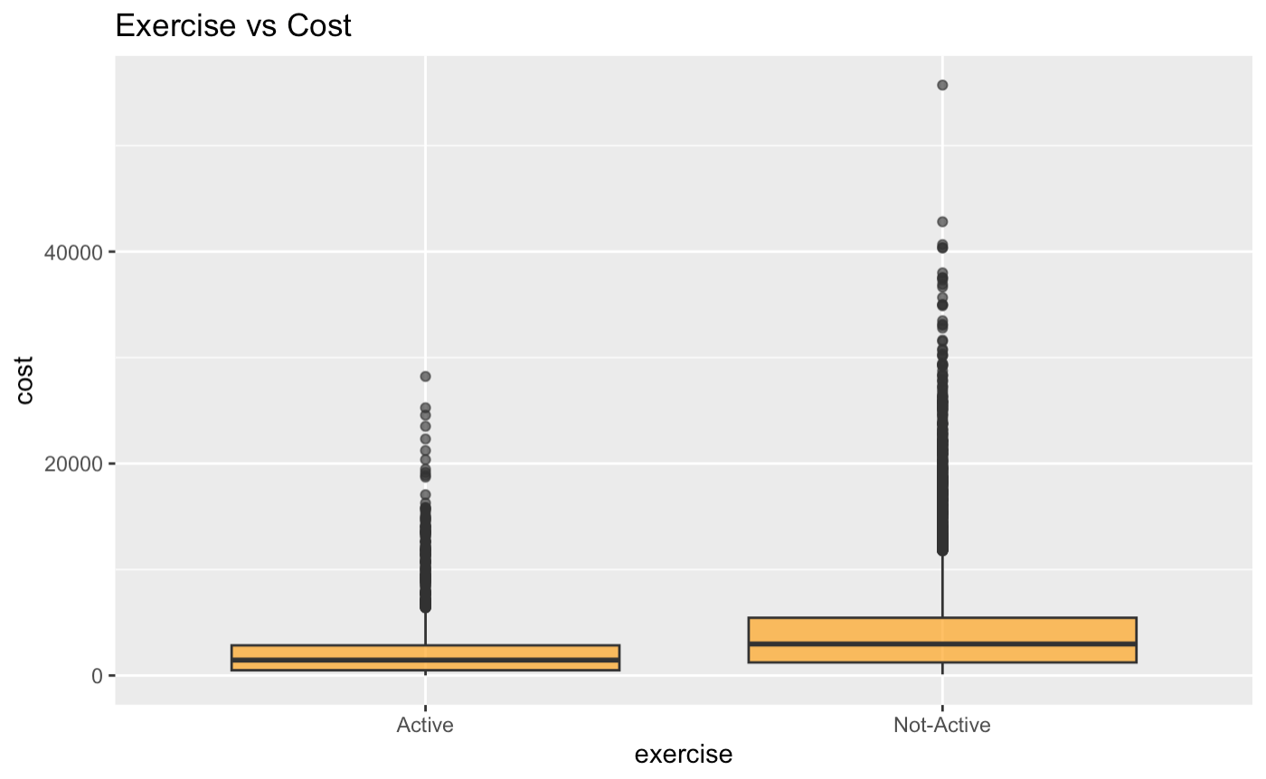
Exercise

Slide 14
Which factors have the Moderate effect on healthcare
We found that the factors that affect the healthcare cost moderately are:
1) Number of children a person has
2) Hypertension

Slide 15
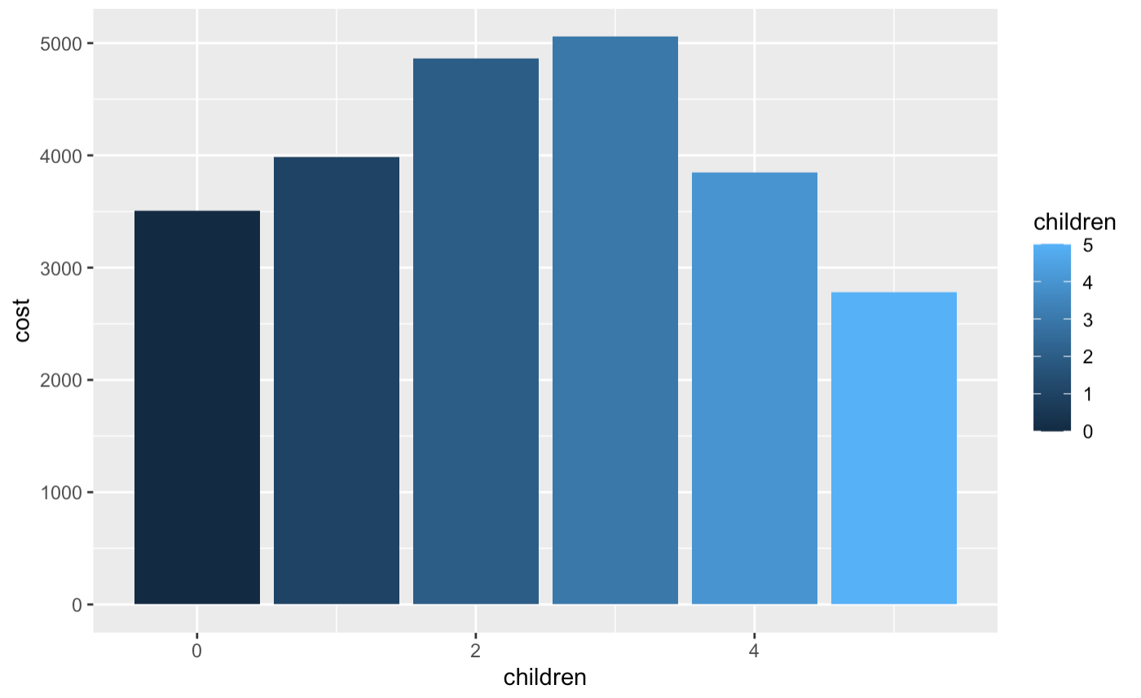
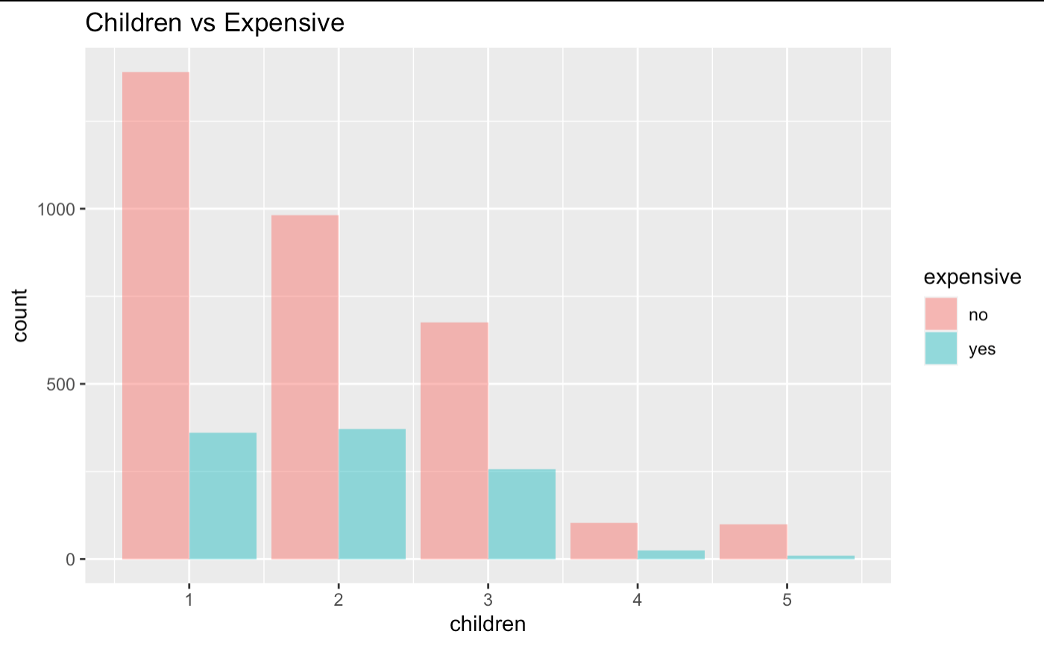

Number of children a person has

Slide 16
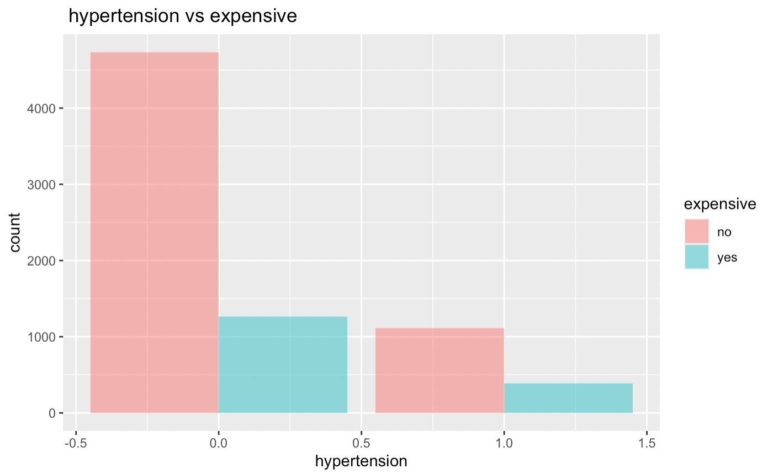
Hypertension

Slide 17

Which factors have the least effect on healthcare
1) Location
2) Gender
3) Yearly-Physical
4) Marriage
5) Education Level

Slide 18
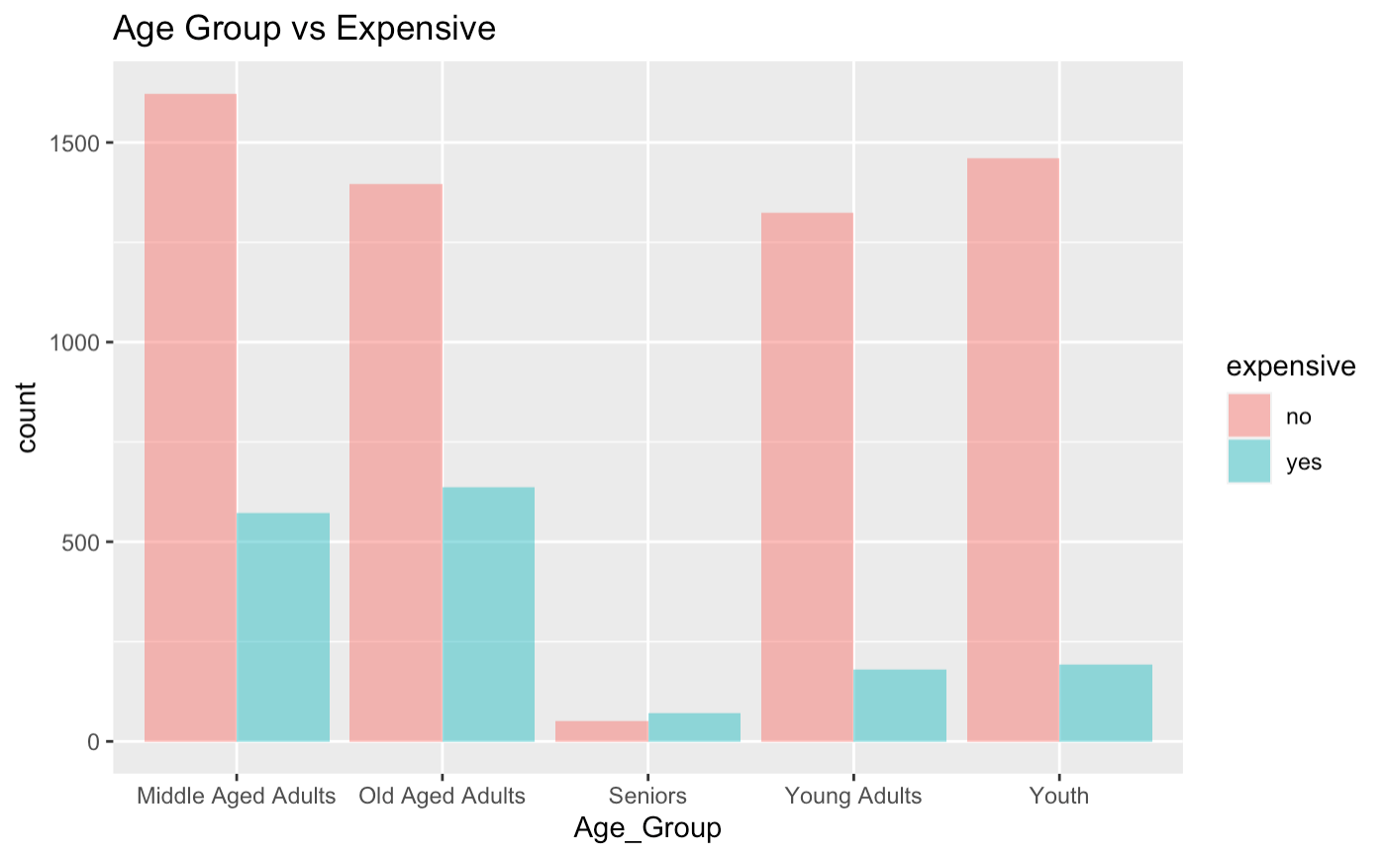
Which age group spends the most on healthcare cost
Age group >=15 and <25 – Youth
Age group >=25 and <35 – Yong adults
Age group >=35 and <50 – Middle-aged adults
Age group >=50 and <64 – Old-aged adults
Age >=64 - Seniors

Slide 19
Models used for predictions
Linear Regression model was first used to identify the significant predictors for the cost / isexpensive column.
These predictors were then used to build the SVM – Support Vector Machine Model.
SVM model is a supervised machine learning model which took the following significant factors: age, BMI, smoking, hypertension, and children to predict the target variable i.e., expensive.
The confusion matrix ran on the SVM model gave an accuracy of 88% and sensitivity of 97%.

Slide 20
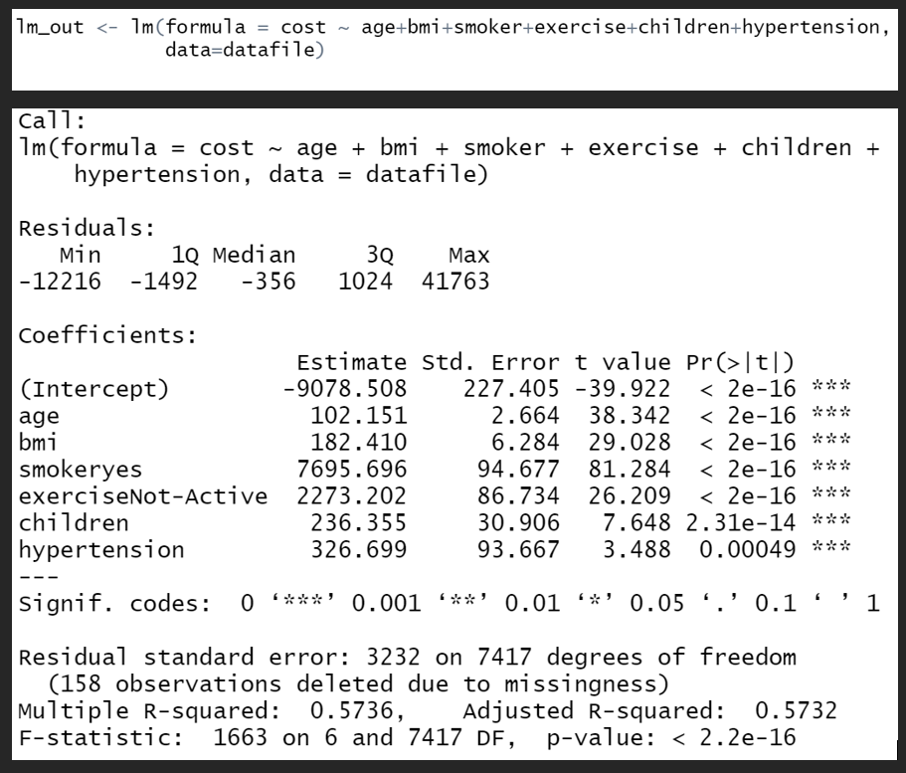
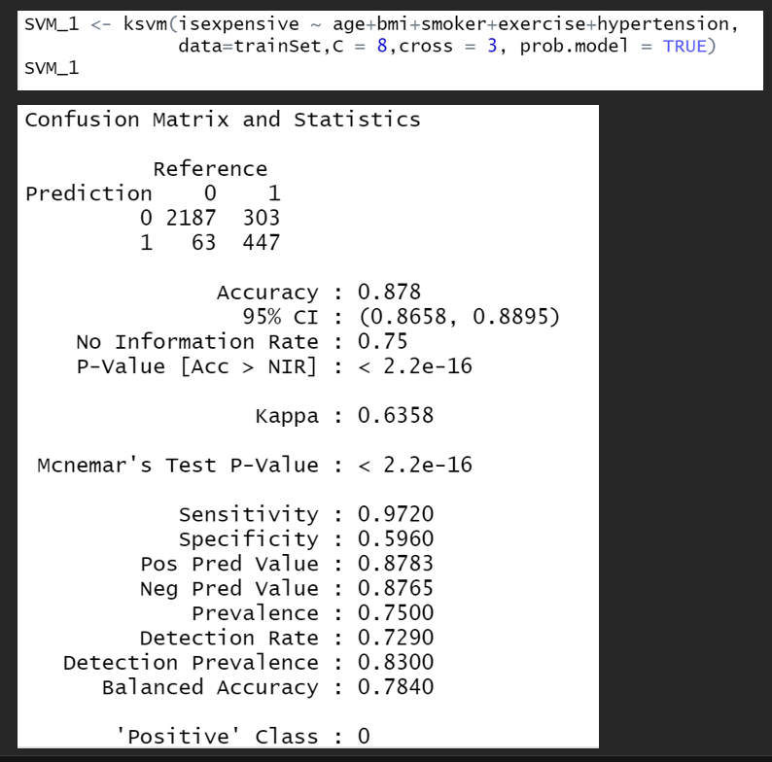
Models used for predictions
LM Model
SVM Model

Slide 21
Recommendations
We have seen through the visualizations and predictions that BMI and smoking have the highest stake in determining the cost and expense of a person. Therefore, we have curated recommendations in such a way that following these, people can effectively reduce their expenses in the following year.
Body Mass Index: BMI is calculated by dividing the weight of a person by the square of their height. Calculation of BMI tells us the risk of being affected by any disease and it is very important to maintain a correct BMI, here are a few ways of achieving it.
Look out for hidden sugar
Get your heart pumping
Do not bother with crash diets
Eat and snack on healthy food

Slide 22
Recommendations
Smoking: The act of inhaling and exhaling the fumes of burning plant material. Tobacco contains nicotine, an alkaloid that is addictive and can have a tranquilizing psychotic effect. Continuous exposure to tobacco can lead to life-threatening diseases. Following are a few measures individuals can take to overcome this addiction and help themselves by reducing the costs of health care.
Try Nicotine replacement therapy
Start exercising
Use of Nicotine patches/ gums
Avoid triggers

Slide 23
Recommendations to HMO
Recommendation for the health management organization would be to collaborate with the health rehabilitation centers to help people get rid of their smoking habits.
They should come up with health care plans and provide benefits.
Pricing of customers can be based on their profile having a model that considers their BMI, smoking habits, exercising history, etc.

Slide 24
Thank you!
Akshitha Reddy
Prachi Sadaranagani
Spruha Band
Yashaswini Kulkarni

